Slide 1
Lecture 6: Species distributions and 2D spatial models
March 29, 2015

Slide 2
Why might we care about 2D spatial models?
Experimental plots
Often uses grid
Observational analysis
Fish surveys

Slide 3
Species distribution models
Widely used tool in zoology, conservation-planning, and invasion biology
Synonyms:
Climate envelop model – Fit model to species observations, and then identify other areas with suitable conditions
Species density model – Sometimes used when fitting to density rather than presence/absence data
Often used to infer “Grinnellian niche”
Distribution is a product of niche, dispersal ability, and species interactions

Slide 4
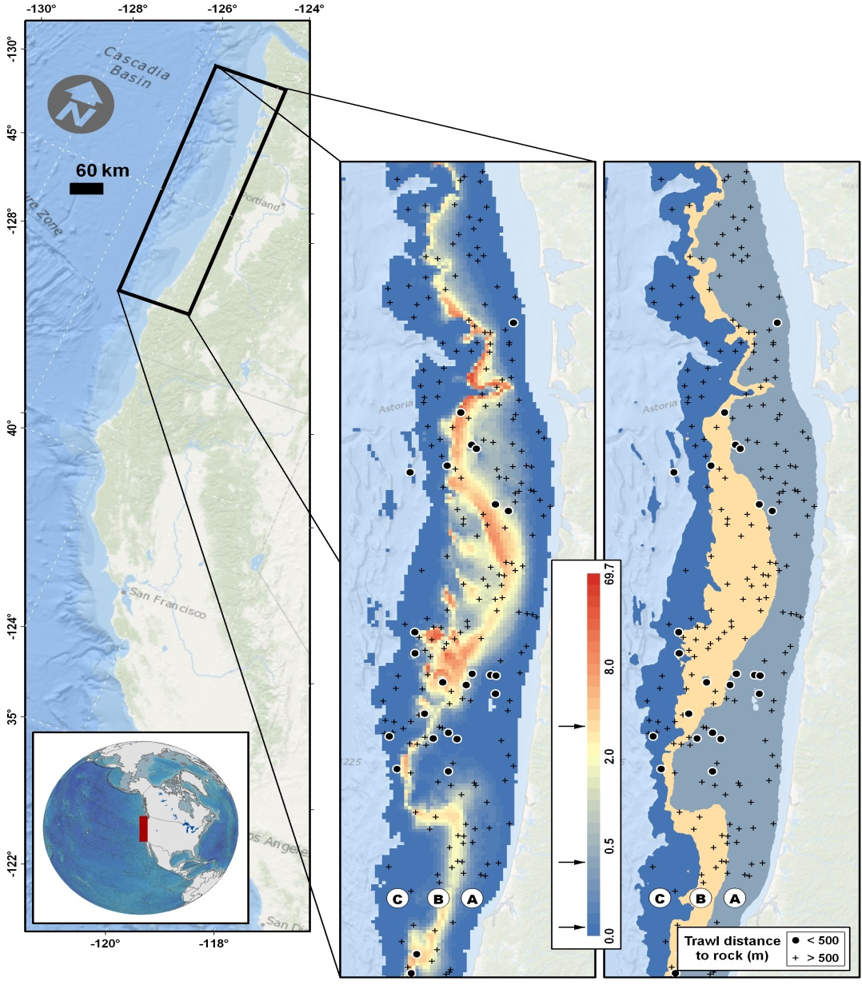
Spatial models are useful for estimating species distribution
Capture fine-scale variation
Decrease residual variation -> Decrease standard errors
Shelton Thorson Ward Feist (2014) CJFAS

Slide 5
Two potential treatments
Equally spaced grid
Unequal or sporadic spacing

Slide 6
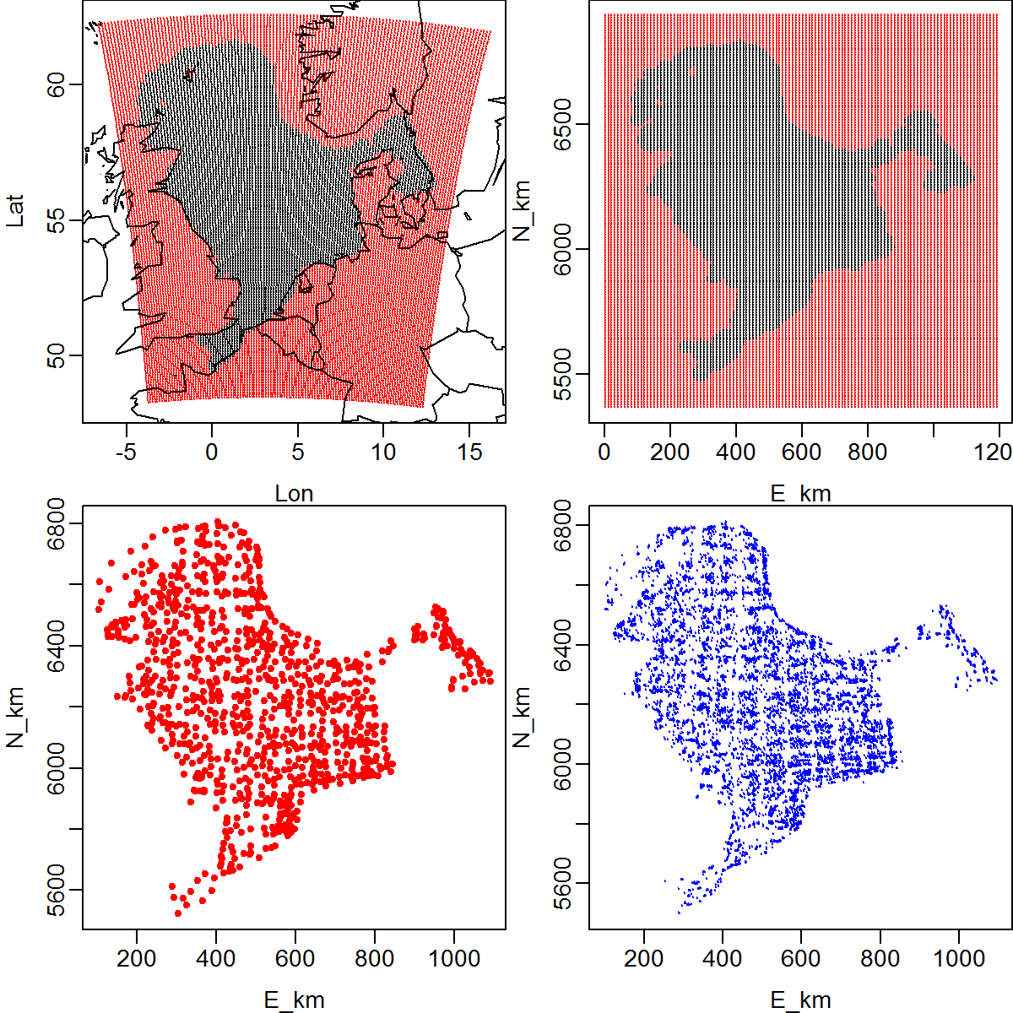
Two potential treatments
Equally spaced grid
Example #1: Divide north sea into grid
Domain of samples
(black: Included)
Location of samples

Slide 7
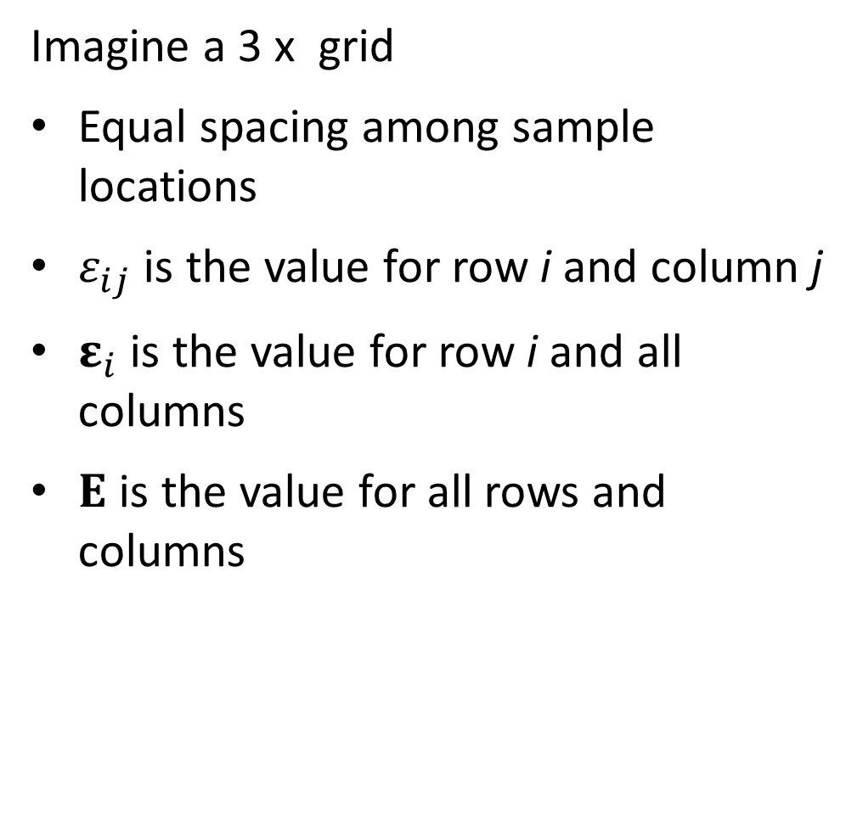
Imagine a 3 x grid
Equal spacing among sample locations
$ε_{ij}$ is the value for row i and column j
$ε_{i}$ is the value for row i and all columns
$Ε$ is the value for all rows and columns

Slide 8

Review
Let’s assume first-order autoregression:
$$ε_{s+1}\sim Normal(ρε_{s},σ_{ε}^{2})$$
Then the joint distribution is multivariate normal
$$ε\sim MVN(0,Σ)$$
where

Slide 9
Intuitive to extend this
What is the distribution for Row #2 conditional on Row #1
[Work through on board]
Row #
1
2
3

Slide 10

Distribution for row i+1 conditional on row i
$$ε_{i+1}\sim MVN(ρε_{i},Σ)$$
Where
i.e., its identical to the 1D case, except replacing the normal distribution with a multivariate normal distribution

Slide 11

Joint distribution of all sites
Then:
$$vec\left(Ε\right)\sim MVN(0,Σ_{total})$$
where

Slide 12
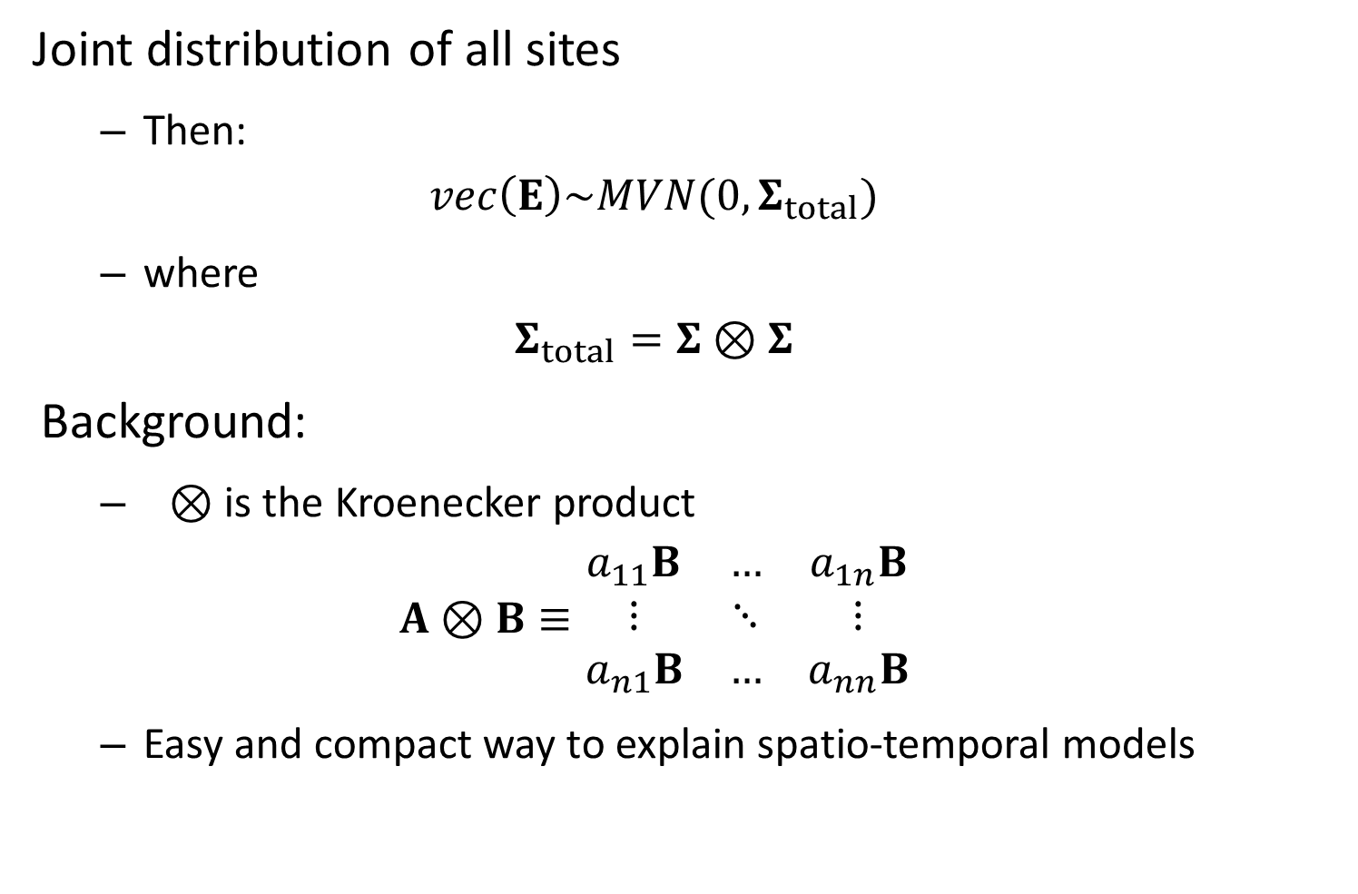
Joint distribution of all sites
Then:
$$vec\left(Ε\right)\sim MVN(0,Σ_{total})$$
where
$$Σ_{total}=Σ⊗Σ$$
Background:
$⊗$ is the Kroenecker product
$$A⊗B≡\begin{matrix}a_{11}B & … & a_{1n}B \\ ⋮ & ⋱ & ⋮ \\ a_{n1}B & … & a_{nn}B\end{matrix}$$
Easy and compact way to explain spatio-temporal models

Slide 13

Kroenecker product inverse is easy
$$Σ_{total}^{−1}={\left(Σ⊗Σ\right)}^{−1}=Σ^{−1}⊗Σ^{−1}$$
where we know how to calculate $Σ^{−1}$

Slide 14
Two potential treatments
Equally spaced grid
Unequal or sporadic spacing
SPDE method
“Stochastic partial differential equation” approximation
Lindgren, Rue, and Lindström. J. R. Stat. Soc. Ser. B Stat. Methodol. 73, 423–498 (2011).
Uses a Matern covariance function
We’ve been using an exponential covariance function
Derived using “finite element analysis”
Divides area into triangles

Slide 15
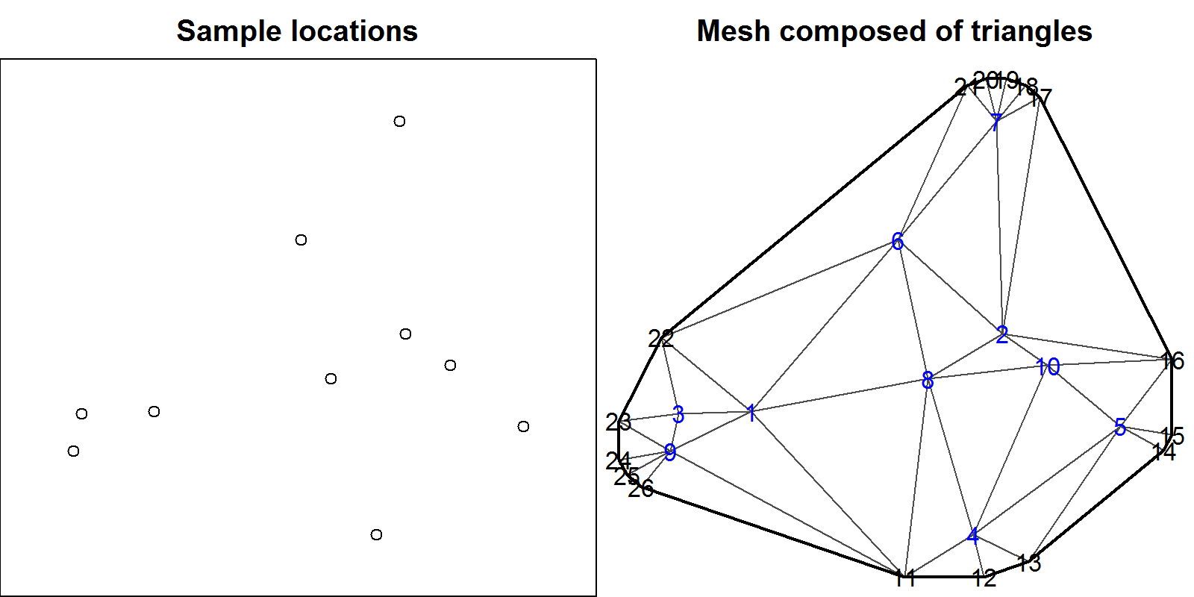
Two potential treatments
Equally spaced grid
Unequal or sporadic spacing

Slide 16
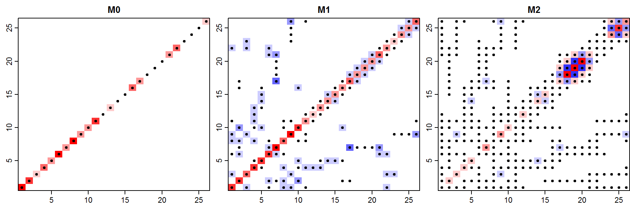

Joint distribution
$$ε\sim MVN\left(0,Σ\right)$$
Which can reduce to a linear form:
$${Σ^{−1}= κ}^{4}M_{0}+2κ^{2}M_{1}+M_{2}$$
$$M_{2}=M_{1}{M_{0}}^{−1}M_{1}$$

Slide 17

Why is the SPDE approximation good?
Faster computation when using precision matrix
$$\operatorname{Pr}\left(ε | Σ\right)∝\sqrt{det(Q)}\exp\left(−0.5ε^{T}Qε\right)$$
Can be used for a regular grid
Generalizes other simple cases

